Slide 1
ICT Project Management

Slide 2
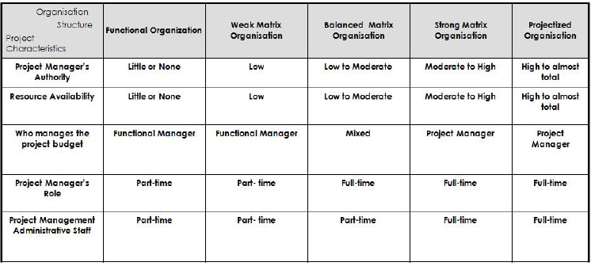
Organization Type- PM influence

Slide 3
Organization Type- Functional Organization
A functional organization is a common type of organizational structure in which the organization is divided into smaller groups based on specialized functional areas, such as IT, finance, or marketing.
Employees are grouped by their knowledge and skills, which helps achieve the highest degree of performance.

Slide 4
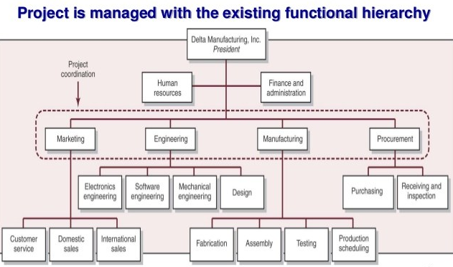
Organization Type- Functional Organization

Slide 5
Organization Type- Weak Matrix
Power enjoyed by the functional manager completely.
Project manager works like a project coordinator or project expeditor.
Project coordinator can take Low bit decision on the allocation of the resources
Project expeditor works only like communicator point between the customer and team.
Project manager reports to functional manager

Slide 6
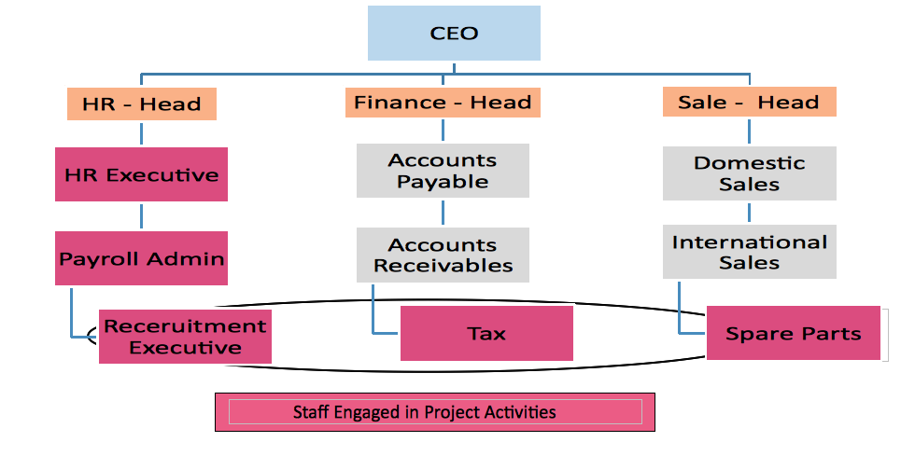
Organization Type- Weak Matrix

Slide 7
Organization type- Balanced Matrix
Reasonable authority to project manager.
Power enjoyed by the functional as well as project manager in the same manner.
Resources working on the project face a complex communication.
It is not clear – whom to report and who is the real boss.

Slide 8
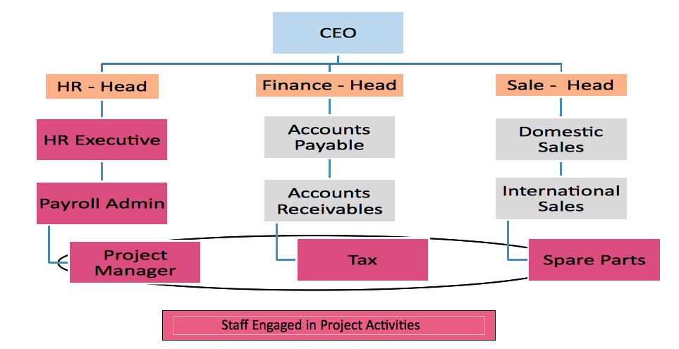
Organization type- Balanced Matrix

Slide 9
Organization Type- Strong Matrix
Power is enjoyed by the project manager little bit more than the functional manager.
PM can take decision on the allocation of the resources
PM can utilize his or her project management skill on the projects.

Slide 10
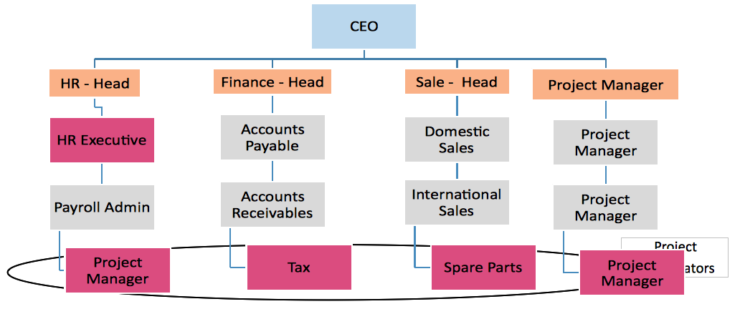
Organization Type- Strong Matrix

Slide 11
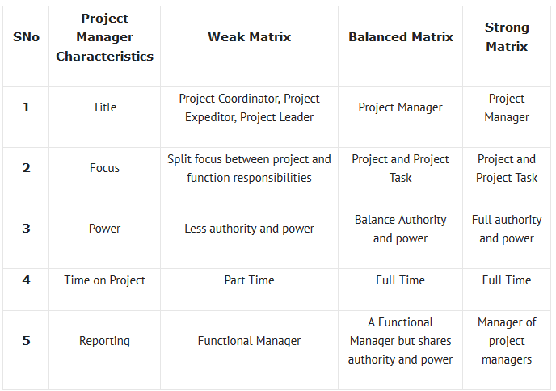
Comparison

Slide 12
Organization type: Projectized
the project manager is in charge of the project, and has full authority over it.
The project manager has full-time team members working under his control who directly report him.
Here, either there will be no functional manager, or if he exists, he will have a very limited role and authority.
Team members responsibility is released after completion of project.

Slide 13
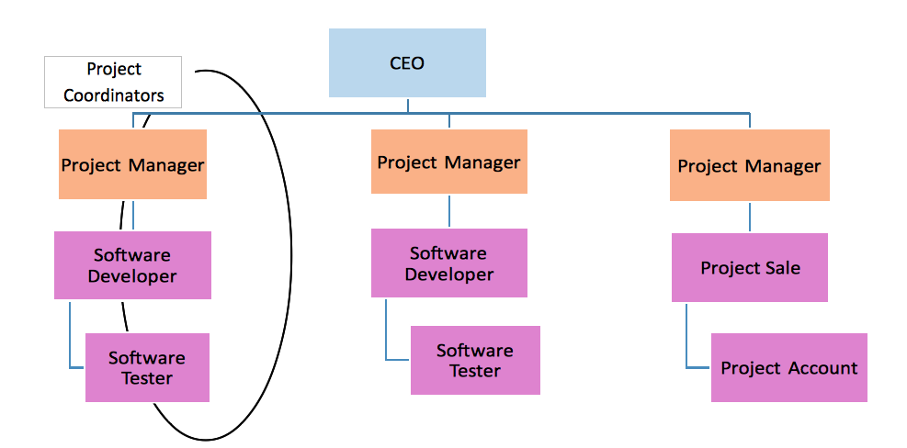

Slide 14
Organization type- Composite
Composite Organization. A composite organization blends the functional, matrix, and projectized types of organizations. A composite is just two or more models that are adapted for a special project, for simplicity, or to keep power in check. Most modern businesses are of the composite type.

Slide 15
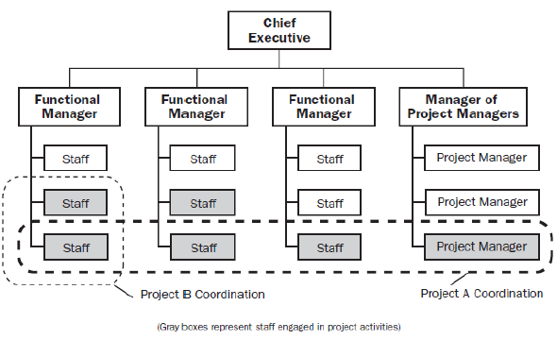
Project type- Composite

Slide 16
Advantages and Disadvantages of different project types
Org. Type | Advantages | Disadvantages
Matrix | Highly visible project adjectives | Not cost effective because of extra administrative staffs
 | PM’s better control over resources | More than one boss for project team
 | Better Coordination | More complex to monitor and control
 | Team members maintain ‘a home’ | High chance of conflict
Functional | Team members report to one supervisor and clearly defined career path | More focused on functional speciality
Projectized | Efficient project organization | Duplication of facilities and job function
 | Loyalty to the project
 | More efficient communication than functional

